Slide 1
RxJS

Slide 2
Реактивное программирование
Реактивное программирование — парадигма программирования, ориентированная на потоки данных и распространение изменений
Observer pattern
Iterator pattern
Functional programming

Slide 3
RxJS
Rx - Reactive Extension
.NET
Java Script
Java
https://github.com/Reactive-Extensions/RxJS/tree/master/dist

Slide 4
Arrays
let array = [1, 2, 3]
for (let i = 0; i < array.length; i++) {
console.log(array[i]);
}
array.forEach ( x => console.log(x));

Slide 5
JS FLOW
for (let i = 0; i < array.length; i++) {
console.log(array[i]);
}
array.forEach ( x => console.log(x));

Slide 6
ARRAY METHODS: MAP
let newArr = arr.map( x => x + 1)
1
2
2
3
3
4

Slide 7
ARRAY METHODS: FILTER
let newArr = arr.filter( x => x > 1)
1
2
2
3
3

Slide 8
АСИНХРОННОЕ ПРОГРАММИРОВАНИЕ
function func2(callback) {
callback('Done!');
}
function func1(message) {
console.log(message);
}
func2 (func1);

Slide 9
АСИНХРОННОЕ ПРОГРАММИРОВАНИЕ
Callback hell
Concurrency gets
increasingly complicated.
Callbacks can run
more than once
Callbacks change
error semantics.
Big Ball of Mud

Slide 10
promises
Улучшение над callback
Вырабатывают только одно значение
Необходимо создавать отдельный промис
на каждый запрос

Slide 11
Event emitter
Events force
side effects.
Events are not
first-class values.
It is easy to miss events
if we start listening too late.

Slide 12
PUSH vs PULL
PUSH
PULL
IoC
one value
functions
promises
values
generators,
iterators
observables

Slide 13
RX PATTERN
RX PATTERN = Observer Pattern + Iterator Pattern
Subscription
Observable
Observer
subscibe
onNext
onError
onCompleted
Subject

Slide 14
Observable
Rx.Observable
.from([‘Ivan’, ‘Petr’, ‘Sergey’])
.subscribe(
x =>{ console.log('Next: ' + x); },
err => { console.log('Error:', err); }
( ) => { console.log('Completed'); }
);

Slide 15
Observer
var observer = Rx.Observer.create(
x =>{ console.log('Next: ' + x); },
err => { console.log('Error: ' + err); },
( ) { console.log('Completed'); }
);

Slide 16
From Event
var allMoves = Rx.Observable.fromEvent(document, 'mousemove');
allMoves.subscribe(e => { console.log(e.clientX, e.clientY); });
allMoves
.map(e => e.clientX)
.filter(x => x < window.innerWidth / 2 )
.subscribe(e => console.log(‘mouse on the left’);

Slide 17
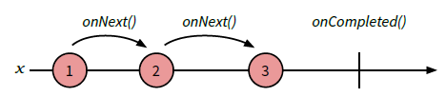
Marbel diagrams
Rx.Observable.range(1, 3);

Slide 18
interval
var a = Rx.Observable.interval(200).map(function(i) {
return 'A' + i;
});
var b = Rx.Observable.interval(100).map(function(i) {
return 'B' + i;
});

Slide 19
subscription
let observable = Rx.Observable.interval(1000);
let subscription = observable.subscribe(x => console.log(x));
subscription.dispose( );

Slide 20
take
let observable = Rx.Observable.interval(1000)
.take(5);
observable.subscribe(x => console.log(x));

Slide 21
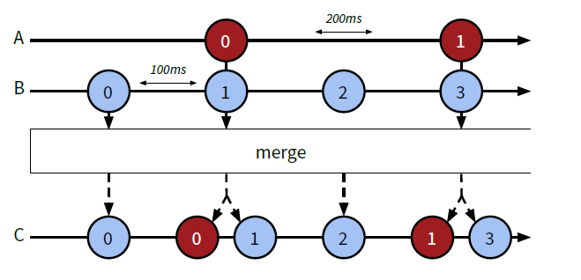
merge
var a = Rx.Observable.interval(200).map(i => 'A' + i);
var b = Rx.Observable.interval(100).map(i => ‘B' + i);
Rx.Observable.merge(a, b).subscribe(x => console.log(x));

Slide 22
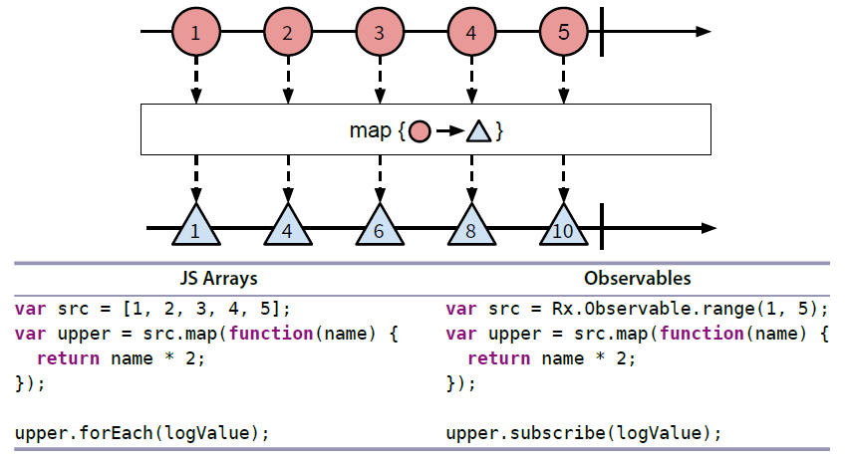
map

Slide 23
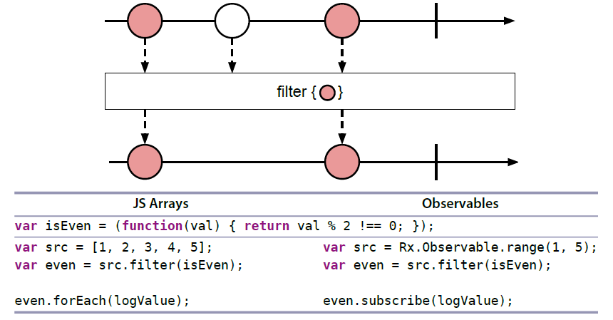
filter

Slide 24
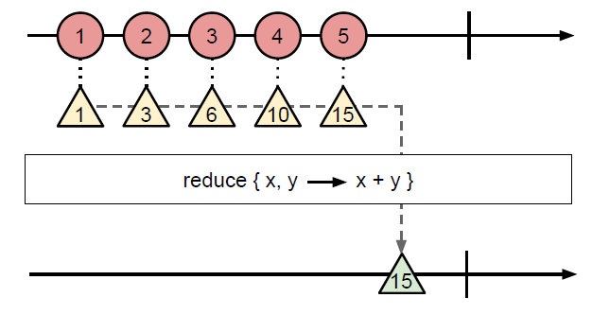
reduce
var src = Rx.Observable.range(1, 5);
var sum = src.reduce( (acc, x) => acc + x);
sum.subscribe(logValue);

Slide 25
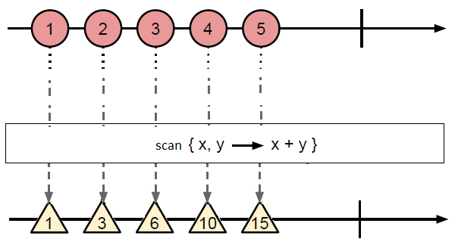
scan
var src = Rx.Observable.range(1, 5);
var sum = src.scan( (acc, x) => acc + x);
sum.subscribe(logValue);

Slide 26
Custom Observable
Rx.Observable.create( (observer) => {
observer.onNext (someValue);
…
observer.onError(new Error(‘some error’));
…
observer.onCompleted( );
});

Slide 27
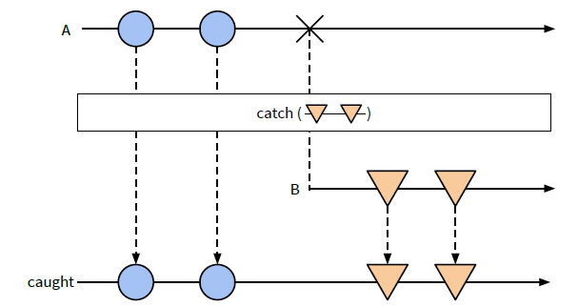
Handling Error
let caught = observable.catch(
Rx.Observable.return({
error: “Some details”
})
);

Slide 28
Handling Error
Rx.DOM
.get('/products')
.retry(5)
.map(xhr => xhr.result)
.subscribe(
result => console.log(result),
err => console.error('ERROR: ', err)
);

Slide 29
Handling Error
var observable = Rx.Observable
.fromEvent (button, ‘click’)
.throttle(500)
.flatMap( ( ) => Rx.DOM.get(‘products’))
.retry(5)
.map(xhr => xhr.result);
observable.subscribe(
result => console.log(result),
err => console.error('ERROR: ', err)
);

Slide 30
Hot and Cold Observables
Работают сразу же
Нужен подписчик
Для каждого подписчика –
своя последовательность

Slide 31
Cold -> Hot
var hotObservable = coldObservable.publish( );
// код
hotObservable.connect( );

Slide 32
The Game
10
Map
Bombs

